Slide 1
Lab safety
Note for lab safety training/talk on Nov.20, 2011
Environmental Health & Safety website: http://www.depts.ttu.edu/ehs/Web/

Slide 2
Required documents
SOPs for anything potentially dangerous
Including how to change MOCVD bubbler, dump sharp/chemical waste, use fume hood
Lab safety plan – must have, in written form
Approved by PI
Risk analysis from EHS (optional)
eg. annual inspection, training
MSDS
Storage(flammable/reactive)
Shipping requirements

Slide 3
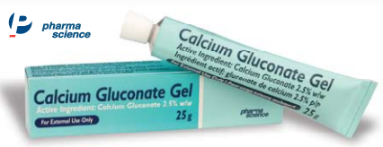
Training
Location of first-aid, fire extinguishers and spill kits
Personal Protective Equipments (PPE)
Gloves: one time use, take off inside-out and dump in regular trash
Body cover: no exposed skin from waist down
Shoes: full foot coverage, no cloth or absorbent materials
Eyewear, respirator/ventilation
Waste management
Waste chemicals: separately stored in labeled containers mark with full name and date.
Waste sharp items: special container or sharp edge secured
Notes:
Respirator: only use when necessary, (try ventilation first) – Must have annual “fitting test”

Slide 4
Training
Chemical Hygiene
Designated area - fume hood: sash below mark
Separate flammable/reactive/waste inside fume hood
Glassware: rinse after use, label if left in fume hood
Store chemicals accordingly
Separate flammable/inflammable, base / acid, HF
Specialized cabinet / refrigerator (EHS can provide)
Handle spills: call (2-3876) immediately if unsure
Use spill kits if comfortable
HF: especially dangerous, penetrate gloves in seconds.
Notes:
Spills: MUST call if mercury. Care if deal with self about carcinogen, mutagen, reactive,

